Slide 1
Getting started on FRDM KL25Z Platform
COEN6711 MICROPROCESSORS AND THEIR APPLICATIONS
FALL 2014
CONCORDIA UNIVERSITY

Slide 2
Outline:
2
FRDM Platform
a KL25Z128VLK4 features
Keil MDK5
2.a Introduction to Keil
2.b Installing Keil
Installing OpenSDA driver
Attaching the board to PC
4.a Change Boot loader
Demo(LED blinking project)
Sample projects
Tool purchasing guide

Slide 3
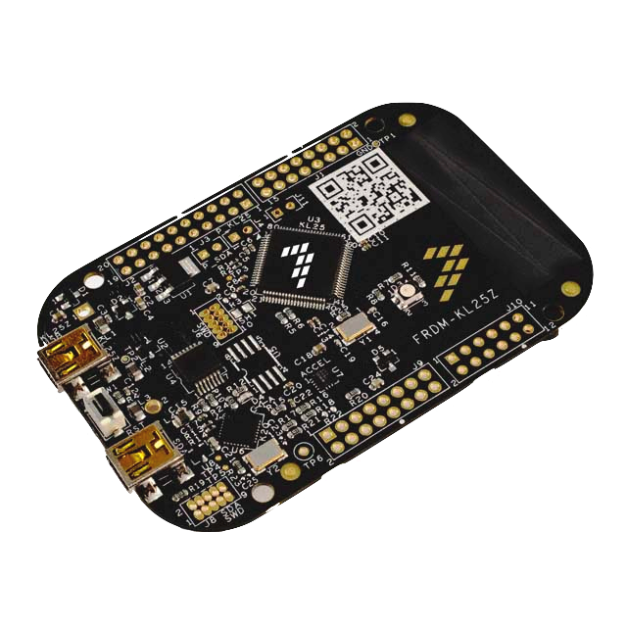

1-FRDM Platform
3
KL25Z128VLK4
ARM CortexM0+ architecture from freescale
MMA8451Q
3-axis accelerometer
OpenSDA programming/debugging interface
Capacitive touch panel
asdas
RGB LED
RGB LED

Slide 4
1.a- KL25Z128VLK4 features:
4
High performance ARM Cortex-M0+ Core
Freescale Kinetis L series
48MHz, 16KB RAM, 128KB FLASH
Communication ports: 2xSPI, 2xI2C, 3xUART, 6xPWM, 6xADC - 16 bit, GPIO
P&E Multilink interface provides run-control debugging and compatibility with IDE tools
Built in capacitive touch sense input (TSI) module

Slide 5
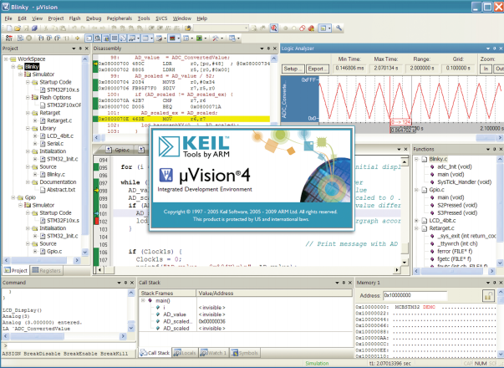

2-a Introduction to Keil MDK5
5
Keil MDK5 is a complete software development environment for almost all of the ARM based microcontrollers. MDK-ARM V5 is the latest version which were released in June 2014.
Flash programming/debugging are supported by Keil
C/C++ compiler
Free RTX RTOS Kernel Library
Free examples and templates
Only Windows compatible

Slide 6
2- b Installing Keil MDK 5
6

Slide 7
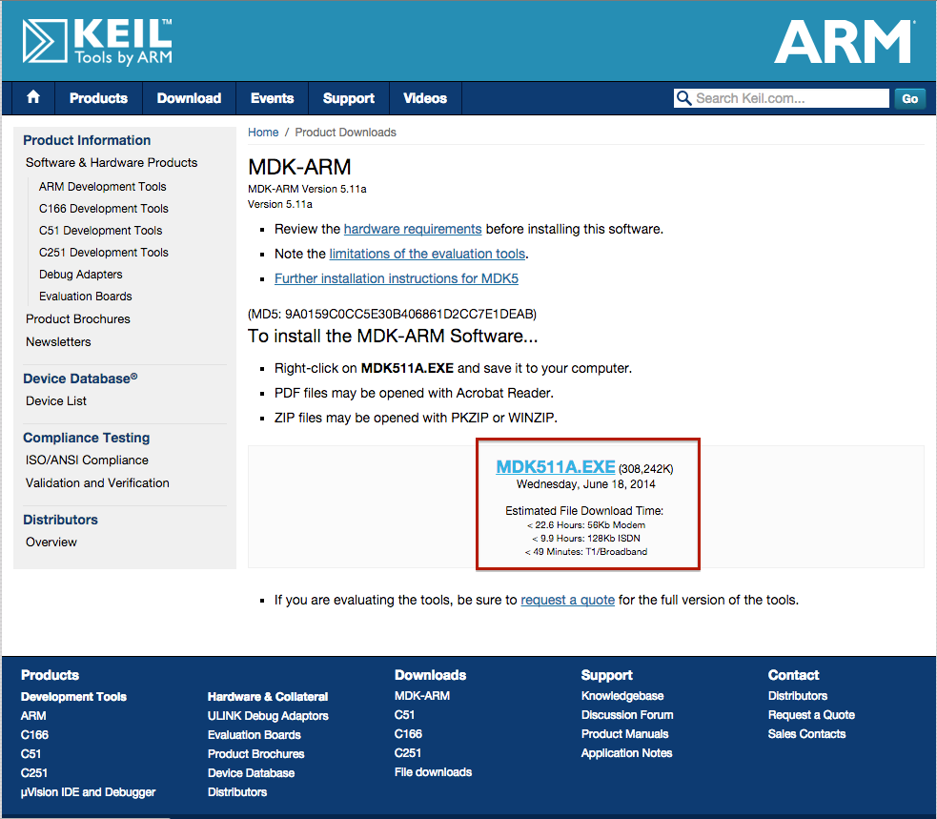
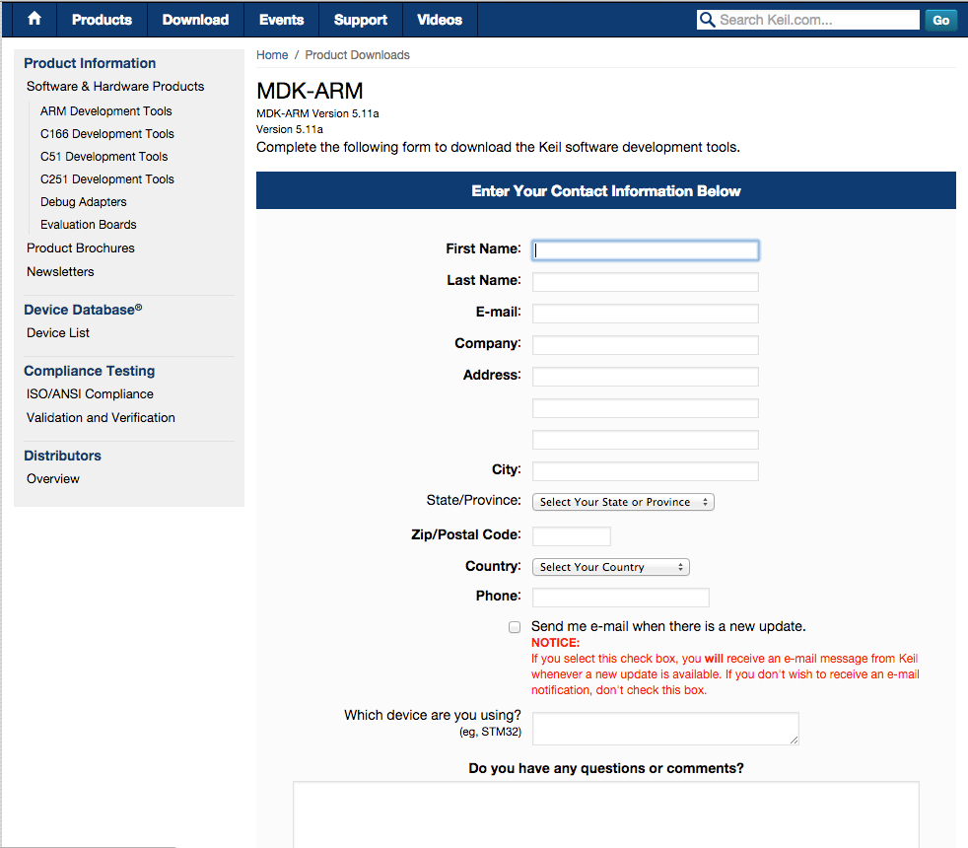
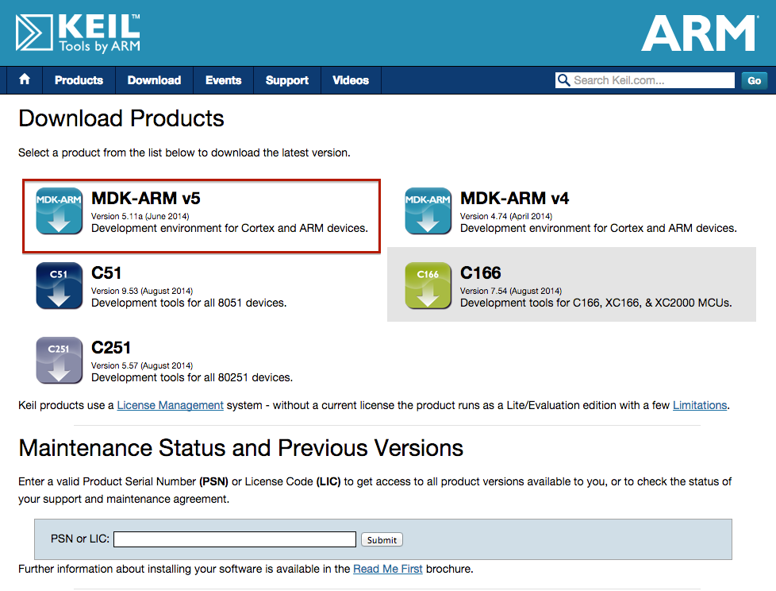
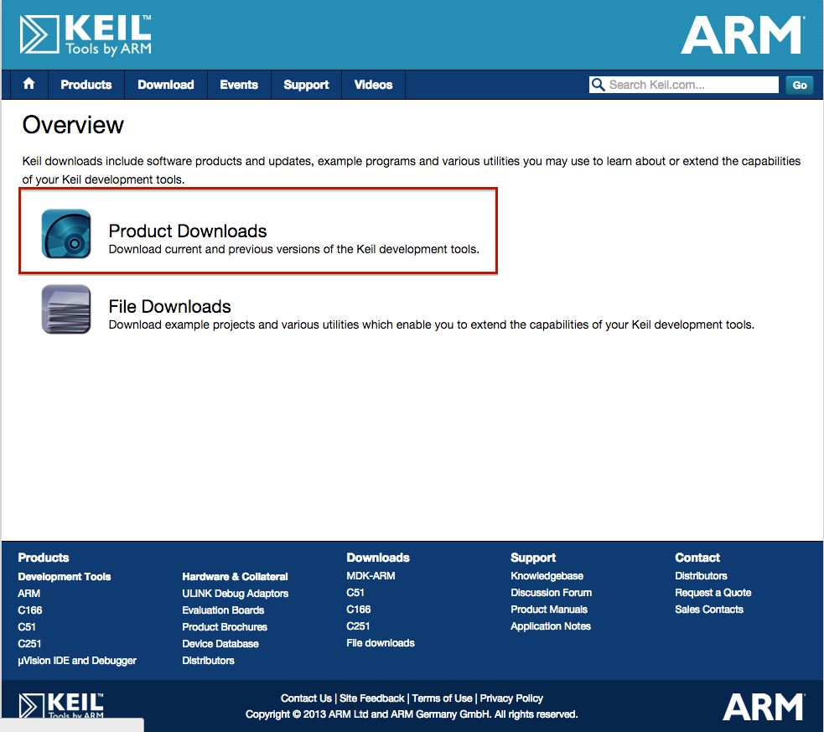
Step1: Download Keil MDK5
7
1. Link to the website: https://www.keil.com/download/
2. Select MDK-ARM v5
3. Fill out the form
4. Download the file

Slide 8
Step2: Install Keil MDK5 and Installer pack
8
1. Installation procedure is straight forward
2. After the installation, you need to install the libraries for your specific micro controller in our case KL25Z128VLK4 from freescale.

Slide 9
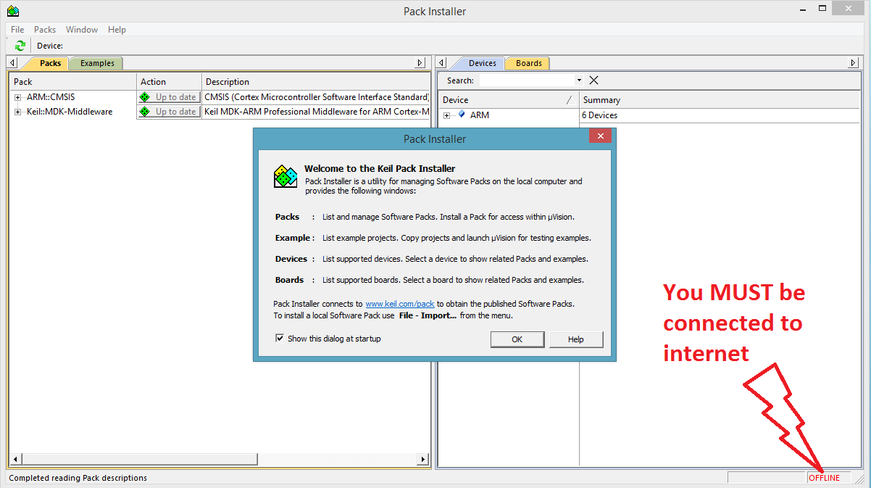
Package installation
9

Slide 10
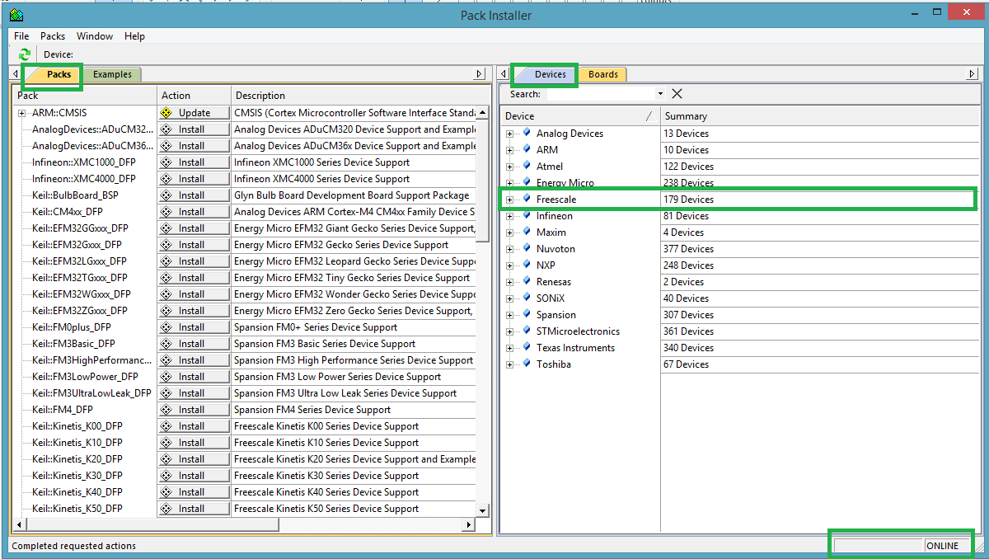
Package installation
10

Slide 11
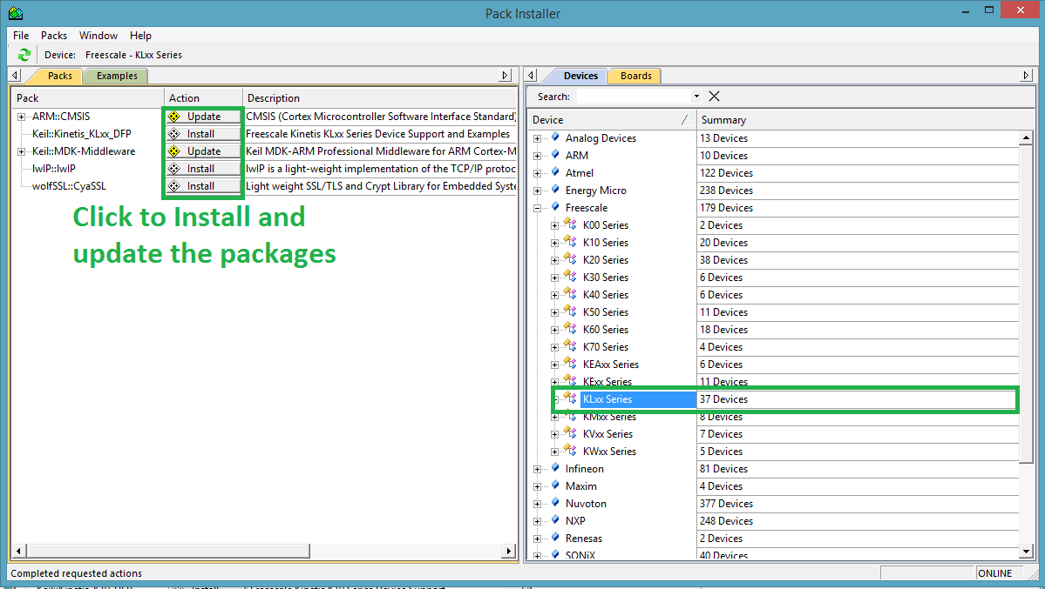
Package installation
11

Slide 12
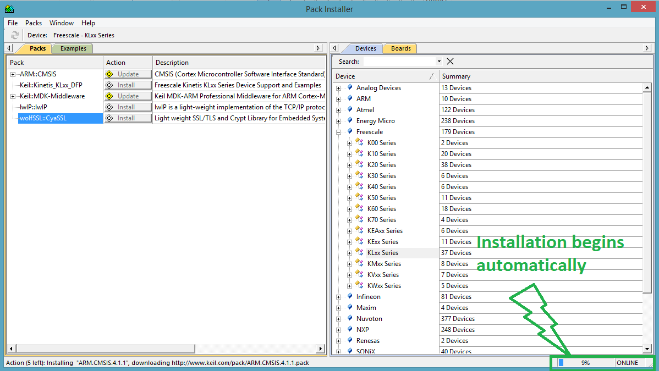
Package installation
12

Slide 13
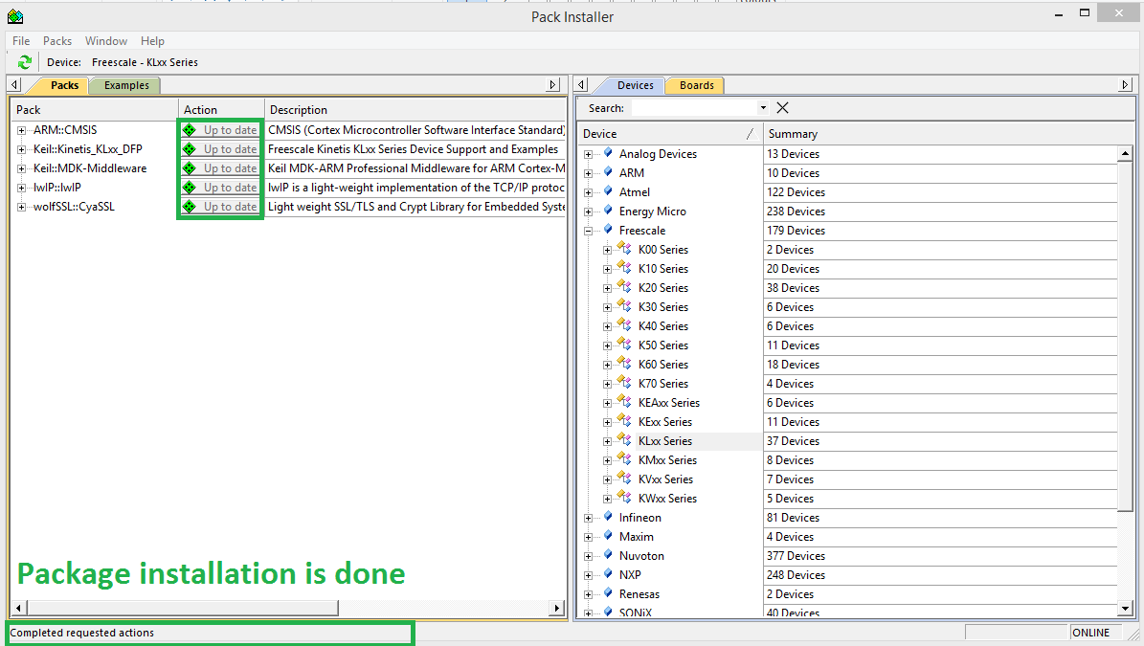
Package installation
13

Slide 14
3. Installing OpenSDA driver
14
P&E OpenSDA Firmware provides the drivers for programming, debugging and communicating with FRDM-KL25Z platform. Without this Firmware you are not able to program your device. You can find the latest version of this software on the P&E micro website . You need to download and install the PEDrivers install.exe under the Windows USB Drivers box.
Link to P&E micro website: http://www.pemicro.com/opensda/

Slide 15
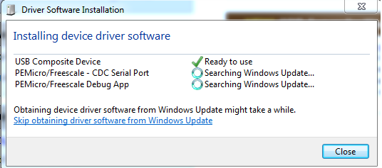
4. Attaching the board to PC
15
By now all the necessary drivers for programming FRDM board are installed. Windows will automatically find and install all the proper drivers for the board.

Slide 16
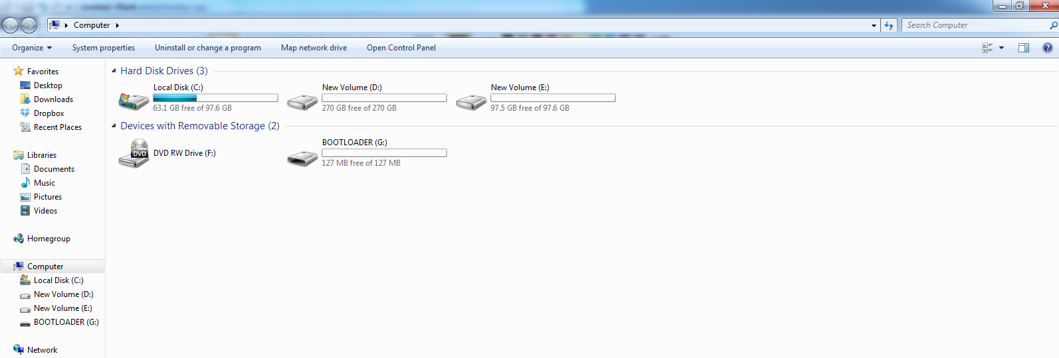
4.a Change boot loader
16
After the first installation of the board to the PC, Windows will detect FRDM-KL25Z as a storage device. Since we are using KEIL MDK5 as our programming environment, it will be more convenient to program the board using KEIL MDK5 as well. For this purpose, we need to change the pre-installed boot loader. First you need to unplug the board from the USB port and then while you are pressing the reset button re-plug the board to one of your USB ports. This time a boot loader drive will appear on your computer. Now you just need to drag and drop the DEBUG-APP_Pemicro_v108.SDA on this folder so the next time you attach the board, you will be able to program it via KEIL MDK5.
Link to DEBUG-APP_Pemicro_v108.SDA : https://www.dropbox.com/s/e8rarpanuybjehs/DEBUG-APP_Pemicro_v108.SDA
Not compatible with Windows 8.1 and Mac OSX

Slide 17
5. DEMO: LED blinking project
17

Slide 18
6. Sample projects
18
1. Interfacing Line Scan Camera With Freedom KL25Z:

Slide 19
6. Sample projects
19
2. MonkeyListen Demo- Time Domain FFT Mode

Slide 20
7. Tool purchasing guide
20
Board:
1. DigiKey
2. Element14
3. Mouser
USB cable:
1. DigiKey

Slide 21
Questions?
21

